Slide 1


Grafana
&
Prometheus
Done By:
Basmala Khalifa 20226122
Amira Emad 20226017
Raghad Ahmed 20226041
Malak Sherif 20226105

Slide 2
01.The Monitoring Challenge
04. How they work together?
02. Introduction to Prometheus
05. Best Practices & Use Cases
06. Live Demo
03. Introduction to Grafana
The Monitoring Challenge
Contents
Grafana
&
Prometheus
Done By:
Basmala Khalifa
Amira Emad
Raghad Ahmed
Malak Sherif

Slide 3





The Monitoring Challenge
01.The Monitoring Challenge
04. How they work together?
Without Monitoring • Blind to system health • Reactive problem solving • Downtime = Lost revenue • No performance insights • User complaints = First alert
With Monitoring • Real-time visibility • Proactive problem detection • Prevent issues before users notice • Data-driven decisions • Optimize performance & costs
Database
No output !
Payment Gateway
02. Introduction to Prometheus
05. Best Practices & Use Cases
Where is the data?
Where is the Problem?
06. Live Demo
03. Introduction to Grafana
Contents

Slide 4

The Monitoring Challenge
Without Monitoring • Blind to system health • Reactive problem solving • Downtime = Lost revenue • No performance insights • User complaints = First alert
With Monitoring • Real-time visibility • Proactive problem detection • Prevent issues before users notice • Data-driven decisions • Optimize performance & costs
Database
Payment Gateway
What is Prometheus?
Open-source monitoring and alerting toolkit designed for reliability and scalability

Slide 5
Key Features
What It Does
Without Monitoring • Blind to system health • Reactive problem solving • Downtime = Lost revenue • No performance insights • User complaints = First alert
With Monitoring • Real-time visibility • Proactive problem detection • Prevent issues before users notice • Data-driven decisions • Optimize performance & costs
What is Prometheus?
Open-source monitoring and alerting toolkit designed for reliability and scalability

Slide 6

What is Prometheus?
Key Features
What It Does
✓ Time-series database
✓ Pull-based metrics collection
✓ Prometheus query language (PromQL)
✓ No distributed storage dependency
✓ Service discovery
→ Scrapes metrics from targets
→ Stores time-series data
→ Evaluates alert rules
→ Sends alerts via Alertmanager
→ Provides HTTP API for queries

Slide 7

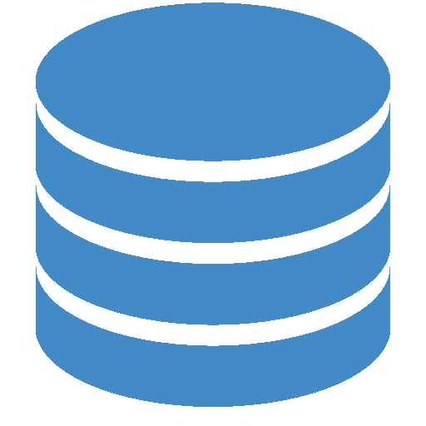
What is Grafana?
What is Prometheus?
Key Features
What It Does
Sends Queries
Without Monitoring • Blind to system health • Reactive problem solving • Downtime = Lost revenue • No performance insights • User complaints = First alert
With Monitoring • Real-time visibility • Proactive problem detection • Prevent issues before users notice • Data-driven decisions • Optimize performance & costs
Metrics Retreival
TSDB
HTTP Server
Stores
Open-source analytics and interactive visualization platform

Slide 8


What is Grafana?
What is Prometheus?
What It Does
Key Features
→ Scrapes metrics from targets
→ Stores time-series data
→ Evaluates alert rules
→ Sends alerts via Alertmanager
→ Provides HTTP API for queries
✓ Time-series database
✓ Pull-based metrics collection
✓ Powerful query language (PromQL)
✓ No distributed storage dependency
✓ Service discovery
Open-source analytics and interactive visualization platform

Slide 9

What is Grafana?
How They Work Together
Key Features
What It Does
✓ Beautiful, customizable dashboards
✓ Multiple data source support
✓ Rich visualization options
✓ Alert notifications
✓ Template & variables
→ Queries data sources
→ Creates visual dashboards
→ Provides real-time updates
→ Enables data exploration
→ Shares insights with teams

Slide 10

What is Grafana?
How They Work Together?
Key Features
What It Does
→ Queries data sources
→ Creates visual dashboards
→ Provides real-time updates
→ Enables data exploration
→ Shares insights with teams
✓ Beautiful, customizable dashboards
✓ Multiple data source support
✓ Rich visualization options
✓ Alert notifications
✓ Template & variables
2
3
1

Slide 11



How They Work Together?
Best Practices & Use Cases
Prometheus
Collect & store
Grafana
Visualize
Your App
Export metrics

Slide 12
How They Work Together?
Best Practices & Use Cases
Infrastructure Monitoring
Server CPU & Memory
Disk I/O
Network traffic
Container metrics
Application Performance
Response times
Error rates
Request throughput
Database queries
Prometheus
Collect & store
Grafana
Visualize
Your App
Export metrics

Slide 13
Best Practices & Use Cases
Business Metrics
User signups
Sales transactions
API usage
Feature adoption
Infrastructure Monitoring
Server CPU & Memory
Disk I/O
Network traffic
Container metrics
Application Performance
Response times
Error rates
Request throughput
Database queries
Alerting & SLOs
Downtime alerts
Performance degradation
SLA tracking
Capacity planning

Slide 14
Best Practices & Use Cases
Infrastructure Monitoring
Server CPU & Memory
Disk I/O
Network traffic
Container metrics
Business Metrics
User signups
Sales transactions
API usage
Feature adoption
Alerting & SLOs
Downtime alerts
Performance degradation
SLA tracking
Capacity planning
Application Performance
Response times
Error rates
Request throughput
Database queries

Slide 15

Live Demo Time! 🚀
Best Practices & Use Cases
Business Metrics
User signups
Sales transactions
API usage
Feature adoption
Alerting & SLOs
Downtime alerts
Performance degradation
SLA tracking
Capacity planning

Slide 16

Our Repo !
https://github.com/basmala352004/Grafana-and-Prometheus-Monitoring.git

